Slide 1
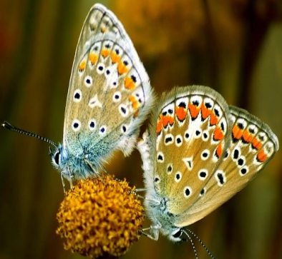
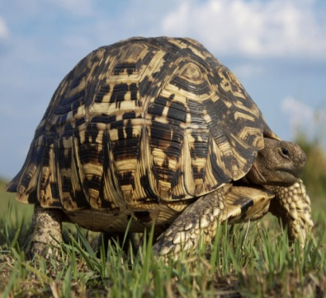
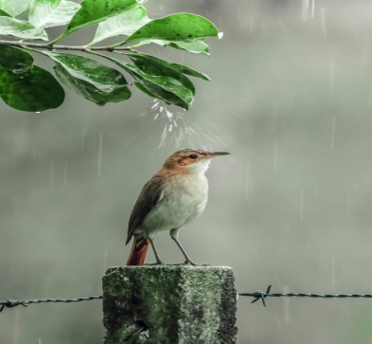
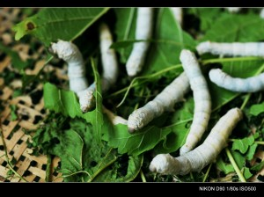
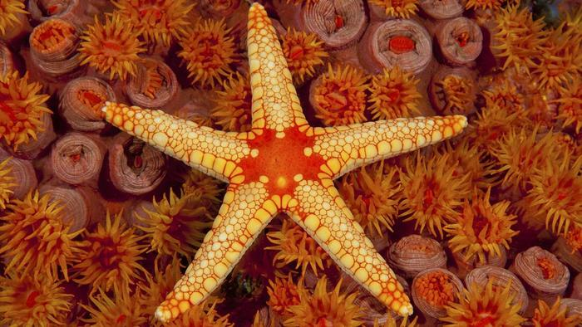
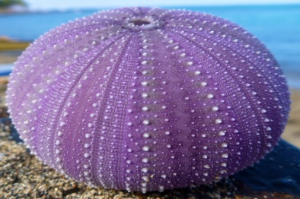
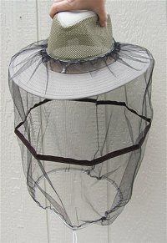
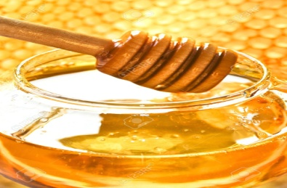
A.C.S. College, Alkuti.
S. Y. B. Sc.
Practical's
Prof. Ughade P. K. (M.Sc.- Entomology)

Slide 2
Index
1. To study of classification with reasons of the following Phylum- Arthropoda: Scorpion, Crab, Cockroach, Head louse, Centipeds, Peripatus.
2. To study of the classification with reasons of the following Phylum- Mollusca: Chiton, Snail, Bivalve, Dentalium, Octopus.
3. To study of the classification with reasons of the following Phylum- Echinodermata: Starfish, Brittle star, Holothurian, Sea urchin, Echinus.
4. To study of permanent slides of mouthparts: Cockroach, Mosquito, Plant bug, Bed bug, Butterfly, Honey bee.
5. a) To study of shell: Chiton, Pila, Sepia, Pecten, Dentalium.
b) To study of foot: Chiton, Patella, Aplysia, Sepia, Octopus, Dentalium.
6. To study of external characters and digestive system of starfish.
7. To study of water vascular system of Starfish.
8. a) To study of permanent slides of T.S. of arms and types of pedicellaria of Starfish.
b) Larval forms in Echinodermata (Bipinnaria and Brachiolaria)
9. Identification, Classification and study of Habit, Habitat and economic importance of
a) Rohu, Catla, Mrigal, Pomphret.
b) Prawn, Crab, Oyster.

Slide 3
10. Study and maintenance of Aquarium.
11. Study of Any three types of Crafts and Gears.
12. To study of Insect pest with respect to marks of identification nature of damage and
economic importance.
13. To study of pest control appliances.
14. To study of classification with reasons of the following animals Class Reptilia:
Cobra, Garden lizard, Turtle Rat snake, Draco.
15. To study of classification with reasons of the following animals:
Class- Aves: Sparrow, Crow, Parrot, Woodpecker
Class Mammals- Rabbit, Mungoose, Kangaroo.
16. Identification of Poisonous and Non- Poisonous snake.
17. To study of Modification of beaks and feet in Birds.
a) Beak- tearing and piercing, fruit eating, mud probing, fish catching, wood chiselling and
flower probing
b) Feet- perching, raptorial, climbing, swimming, running
18. To study of external characters and digestive system of Scoliodon.

Slide 4
19. To study of Brain of Scoliodon
20. a) Temporary preparation of placoid scale from Scoliodon.
b) Study of Cranial Nerves, eye ball muscles of Scoliodon.
c) Study of Membranous labyrinth of Scoliodon
21. a) To study of life cycle of Honey bee.
b) Study of Mouthparts, thoracic appendages (legs and wings) and sting apparatus of
Honey bee
22. To study of various beekeeping equipment's.
23. To study of bee products and bee pests.
24. a) Study of life cycle of Bombyx mori
b) To study of any five equipment's in sericulture.
25. Compulsory submission of field visit report.
26. Compulsory study tour/ Visit.

Slide 5
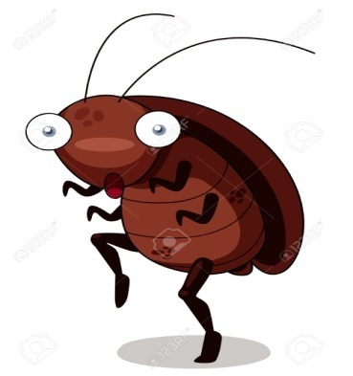
Practical No. 1
Aim- To Study of Classification with Reasons of the following Phylum- Arthropoda: Scorpion, Crab, Cockroach, Head Louse, Peripatus.

Slide 6
General characters of Phylum Arthropoda-
They are bilaterally symmetrical and metamerically segmented.
Body is externally covered by Chitin.
Body is divided into 3 regions- Head, Thorax and Abdomen.
They shows presence of jointed appendages, modified as gills, jaws, legs, wings, etc.
Sense organs are well developed in the form of antennae, compound eyes, taste receptors.
Mouthparts are biting
Digestive system is complete.
Circulatory system is open type.
Respiratory organs are gill, trachea.
Sexes are separate.
Fertilization is internal.
Development is direct or indirect.
They are mostly Oviparous.

Slide 7
Example- 1
1. Scorpion-
Classification-
Phylum- Arthropoda (jointed appendages, metamerically segmented)
Class- Arachnida (air breathing, body divide into prosoma & opisthosoma)
Order- Scorpionidae (Body divided into pro, meso and metasoma, respiration
by 4 pairs of book lungs)
Family- Scorpionoidea
Genus- Palamnaeus
Species- bengalensis

Slide 8
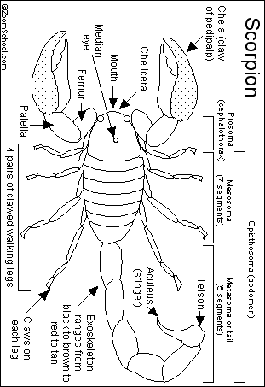
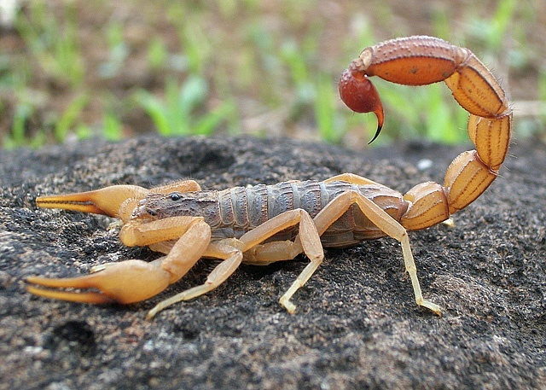
Scorpion

Slide 9
Example- 2
2. Crab:
Classification-
Phylum- Arthropoda (jointed appendages, metamerically segmented)
Class- Crustacea (thick exoskeleton, head fused with thorax)
Order- Decapoda ( 5 pairs of leg)
Family- Portuidae
Genus- Carcinus
Species- meanas

Slide 10
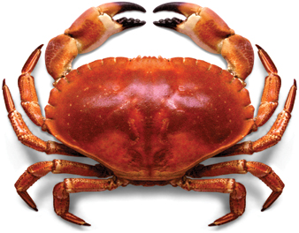
Crab

Slide 11
Example- 3
3. Cockroach-
Classification:
Phylum- Arthropoda (jointed appendages, metamerically segmented)
Class- Insecta (body divided into head, thorax and abdomen)
Order- Dictyoptera ( antennae- filiform, mouthparts- mandibulate type)
Family- Blattidae
Genus- Periplaneta (Straight wing)
Species- americana (Origin in Mexico)

Slide 12
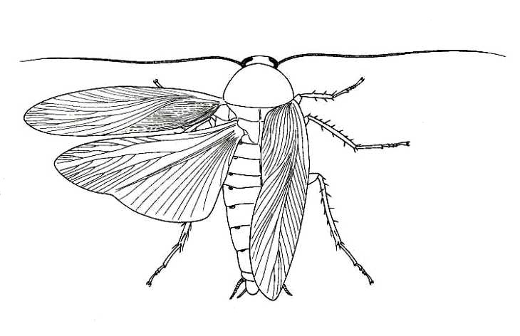
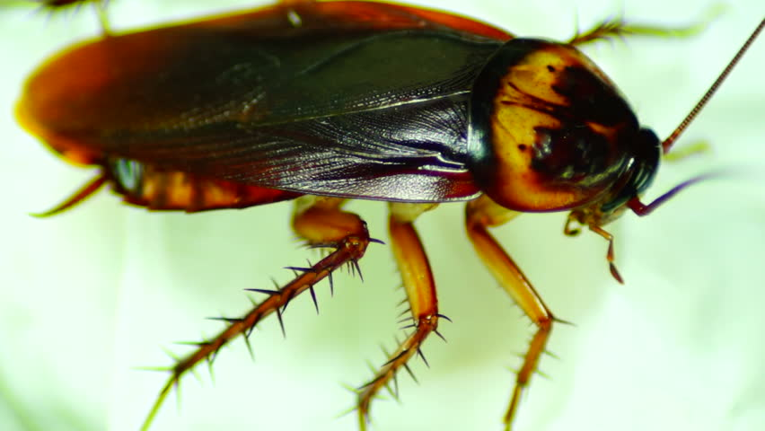
Cockroach

Slide 13
Example- 4
4. Head louse-
Classification:
Phylum- Arthropoda (jointed appendages, metamerically segmented)
Class- Insecta (body divided into head, thorax and abdomen)
Order- Anoplura ( body flattened, cerci absent)
Family- Pediculidae
Genus- Pediculus
Species- humanus

Slide 14
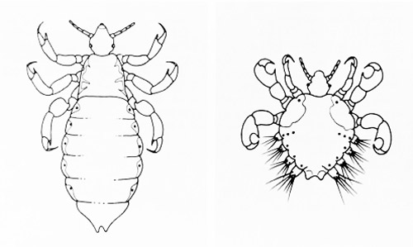
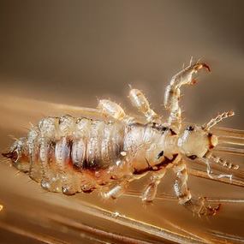
Head Louse

Slide 15
Example- 5
5. Centipeds-
Classification:
Phylum- Arthropoda (jointed appendages, metamerically segmented)
Class- Chilopoda (elongated body with many segments bearing 1-2 pairs
of legs)
Order- Scolopendromorpha( poison jaws present)
Family- Scolopendridae
Genus- Scolopendra
Species- morsitans

Slide 16
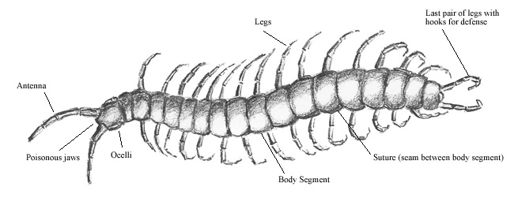
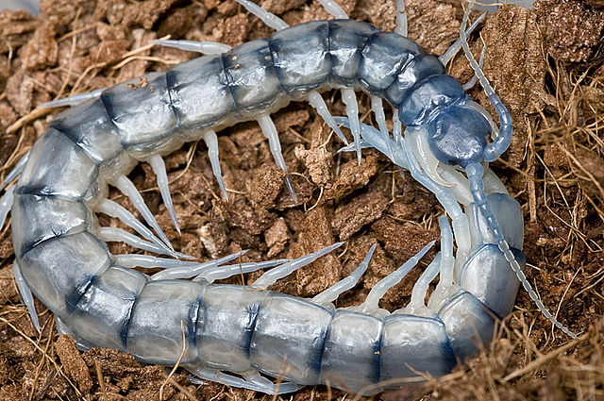
Centipeds

Slide 17
Example- 6
6. Peripatus-
Classification:
Phylum- Arthropoda (jointed appendages, metamerically segmented)
Class- Onychophora (No external segmentation, body slender)
Order- Euonychophora
Family- Peripatidae
Genus- Peripatus
Species-

Slide 18
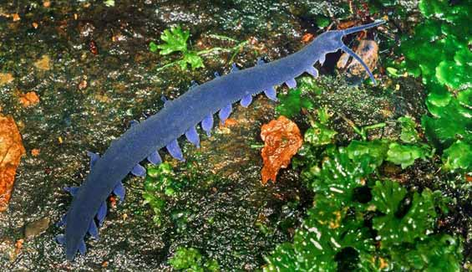
Peripatus

Slide 19
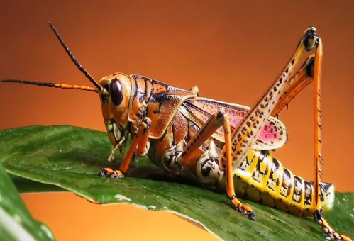
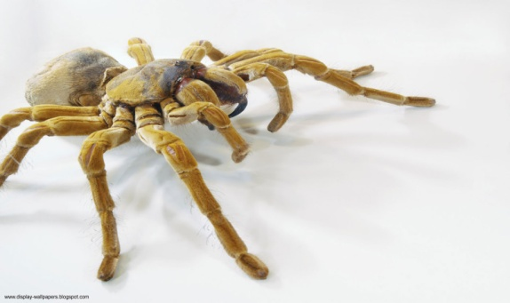
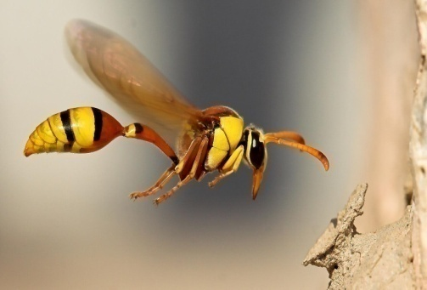
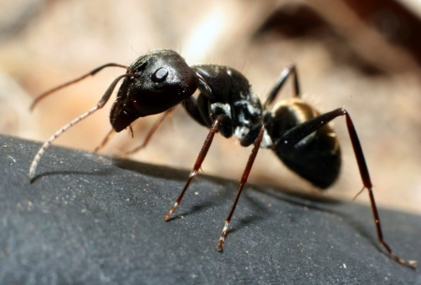
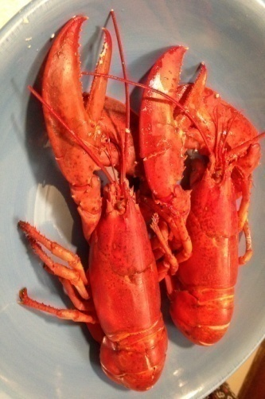
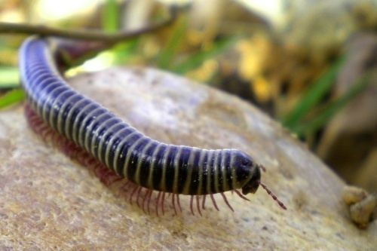
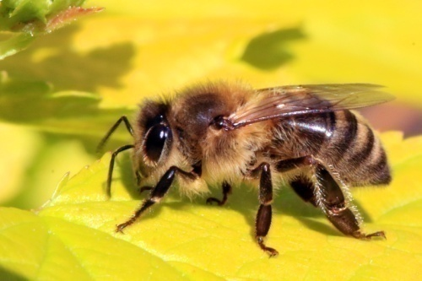
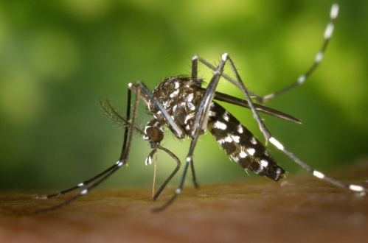
Other examples of Phylum Arthropoda
Grasshopper Spider Wasp Ant
Millipedes Honey bee Lobster Mosquito

Slide 20
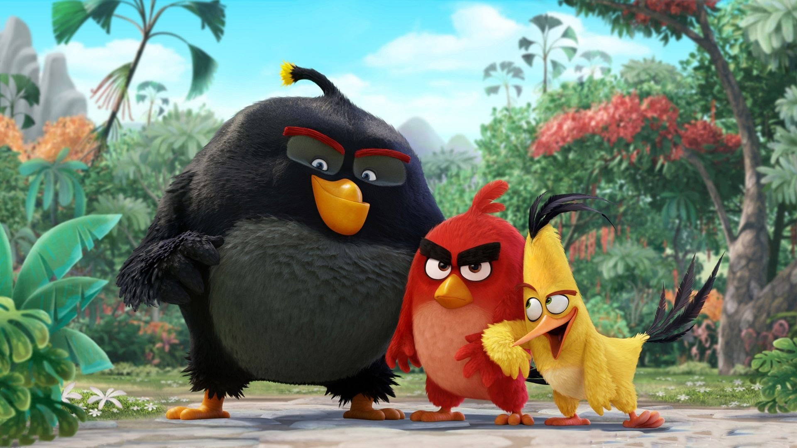
Thank
You

